Slide 1


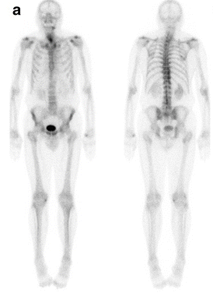
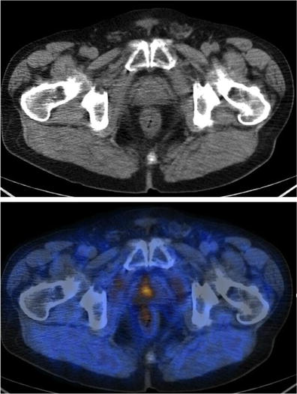
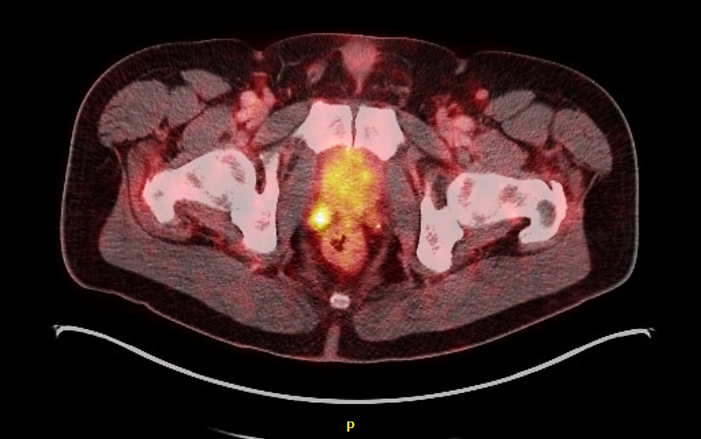
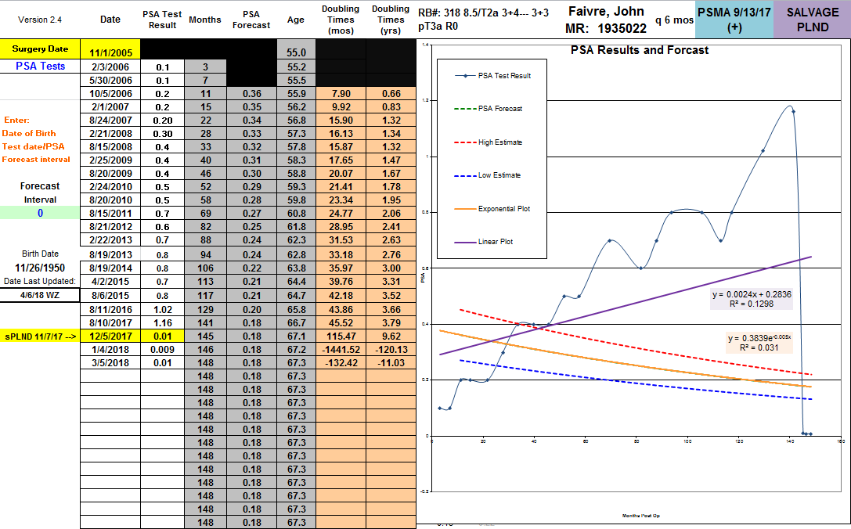

The Integration Of (68)-Ga PSMA PET/CT Imaging In The
Management and Treatment Of Prostate Cancer Recurrence
Linda My Huynh BS, Whitney Zhang, Thomas Ahlering MD
Department of Urology at UC Irvine Health
1. Introduction
with BCR after radical prostatectomy
2
Prostate cancer is the 2nd leading cause of cancer-associated mortality in men
Of the160,000 men diagnosed annually, 90% present with localized prostate cancer and undergo varying primary treatments, of which radical prostatectomy is most oncologically effective
Following treatment, 20-40% of patients experience biochemical recurrence, (PSA ≥0.2ng/mL).
The purpose of the present study is to report our center’s experience with the (68)-Ga PSMA PET/CT for patients with BCR after radical prostatectomy
4. Detection Rate of (68)-Ga PSMA
 | Positive (N=33) | Negative (N=13) | p
Time of RP
Age, mean (SD) | 63.1 (5.8) | 60.7 (4.9) | 0.156
PSA, mean (SD) | 8.6 (5.4) | 9.5 (6.2) | 0.102
pGS |  |  | 0.177
≤3+3 = 1 | 3 | 1
3+4 =2 | 7 | 3
4+3 =3 | 17 | 6
4+4 =4 | 1 | 0
9-10 = 5 | 10 | 2
SVI, no. (%) | 11 (40.7%) | 4 (30.8%) | 0.951
PSM, no. (%) | 11 (40.7%) | 3 (23.1%) | 0.708
Time of PSMA
Age, mean (SD) | 69.1 (7.2) | 66.9 (5.9) | 0.189
PSA, mean (SD) | 3.5 (13.0) | 0.7 (0.3) | 0.039
PSAdt, mean (SD) | 15.4 (33.9) | 31.6 (34.3) | 0.143
2. Background: Detection Rates of Imaging
*bold value indicates p<0.05
5. (68)-Ga PSMA PET/CT – Guided Surgical Therapy
 | Bone Scan | (11)-C Choline | (68)-Ga PSMA
Detection | 9.4% | 24 – 87.8% | ?
Average PSA | 61.3±71.2ng/mL | 9.0ng/mL | ?
3. Materials and Methods
42 consecutive patients who presented with biochemical recurrence post robotic prostatectomy obtained a (68)-Ga PSMA PET/CT scan between October 2016 and April 2018
The primary endpoint was a positive scan and a secondary endpoint was secondary intervention for biochemical recurrence
4. Detection Rates
5. Early Results of Salvage Surgery
4. Factors Contributing to a Positive Scan
 | B | S.E. | Wald | df | p | Exp(B)
PSA at time of PSMA | 4.200 | 1.550 | 7.338 | 1 | 0.007 | 66.684
Gleason (low- v. high-risk) | 2.231 | 1.295 | 2.969 | 1 | 0.085 | 9.312
P-stage (pT2, pT3) | 0.686 | 1.066 | 0.414 | 1 | 0.520 | 1.986
PSAdt (linear, exponential) | -0.586 | 1.148 | 0.261 | 1 | 0.610 | 0.556
Constant | -5.539 | 3.208 | 2.982 | 1 | 0.084 | 0.004
7. Conclusions
A
For men with recurrent prostate cancer post-radical prostatectomy, (68)-Ga PSMA PET/CT:
1) improves detection of recurrence
2) can be used as a tool to guide secondary intervention
B
C
*bold value indicates p<0.05
Notes:
Include salvage detection graph
Delete case report maybe?

